Slide 1
The Financial Aspects of Cybercrime
Anton Moiseienko ANU College of Law
Cyber Law
27 April 2022

Slide 2
Contents
01 | What is cybercrime?
02 | Cybercrime as a business
03 | The role of the traditional financial sector
04 | The role of cryptocurrency

Slide 3
What is Cybercrime?

Slide 4
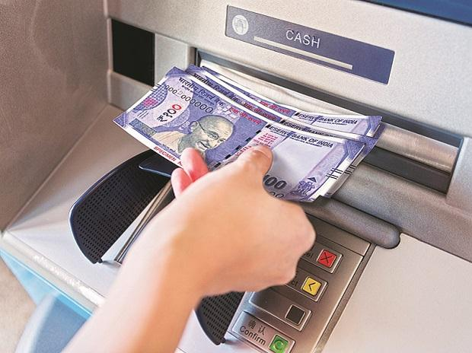
The many faces of cybercrime

Slide 5
National Plan to Combat Cybercrime 2022
Cyber-dependent crime
Directed at computers or other ICT.
Cyber-enabled crime
Increase in scale and/or reach via computers.
Did not exist before computers.
E.g. computer intrusions, DDOS attacks.
E.g. online fraud, identity theft or online child abuse.

Slide 6
Budapest Convention (CoE’s Convention on Cybercrime)
Category | Offence
Offences against the confidentiality, integrity and availability of computer data and systems | Article 2 – Illegal access Article 3 – Illegal interception Article 4 – Data interference Article 5 – System interference Article 6 – Misuse of devices
Computer-related offences | Article 7 – Computer-related forgery Article 8 – Computer-related fraud
Content-related offences | Article 9 – Offences related to child pornography
Offences related to infringements of copyright and related rights | Article 10 – Offences related to infringements of copyright and related rights
In force for Australia since 1 March 2013, 66 states parties in total

Slide 7
Computer Offences in Australia
Division 477 — Serious computer offences
477.1 Unauthorised access, modification or impairment with intent to commit a serious offence
477.2 Unauthorised modification of data to cause impairment
477.3 Unauthorised impairment of electronic communication
Division 478 — Other computer offences
478.1 Unauthorised access to, or modification of, restricted data
478.2 Unauthorised impairment of data held on a computer disk etc.
478.3 Possession or control of data with intent to commit a computer offence
478.4 Producing, supplying or obtaining data with intent to commit a computer offence

Slide 8
Cybercrime beyond cybercrime laws
The men had access to and control over several SIM boxes used to send bulk text messages to tens of thousands of recipients. The text messages claimed to be from Australian banks and telecommunications companies to lure recipients into clicking on various URLs and provide their personal or financial account information.
Charges:
One count of using a telecommunications network with the intention to commit a serious offence, contrary to section 474.14 of the Criminal Code (Cth), where the serious offence is fraud, contrary to section 192E of the Crimes Act 1900 (NSW);
One count of traffic in methamphetamine, contrary to subsection 302.4(1) of the Criminal Code (Cth); and
One count of recklessly dealing with the proceeds of crime, contrary to subsection 400.6(2) of the Criminal Code (Cth).
https://www.afp.gov.au/news-media/media-releases/update-second-man-sms-phishing-scheme-charged-sydney

Slide 9
Draft UN Cybercrime Convention
First meeting of the ad hoc committee took place in March 2022
Draft proposed by Russia provides for the criminalisation of:
Article 18: The creation and use of digital data to mislead the user
Article 19: Incitement to subversive or armed activities
Article 21: Extremism-related offences
Article 24: Rehabilitation of Nazism, justification of genocide or crimes against peace and humanity

Slide 10

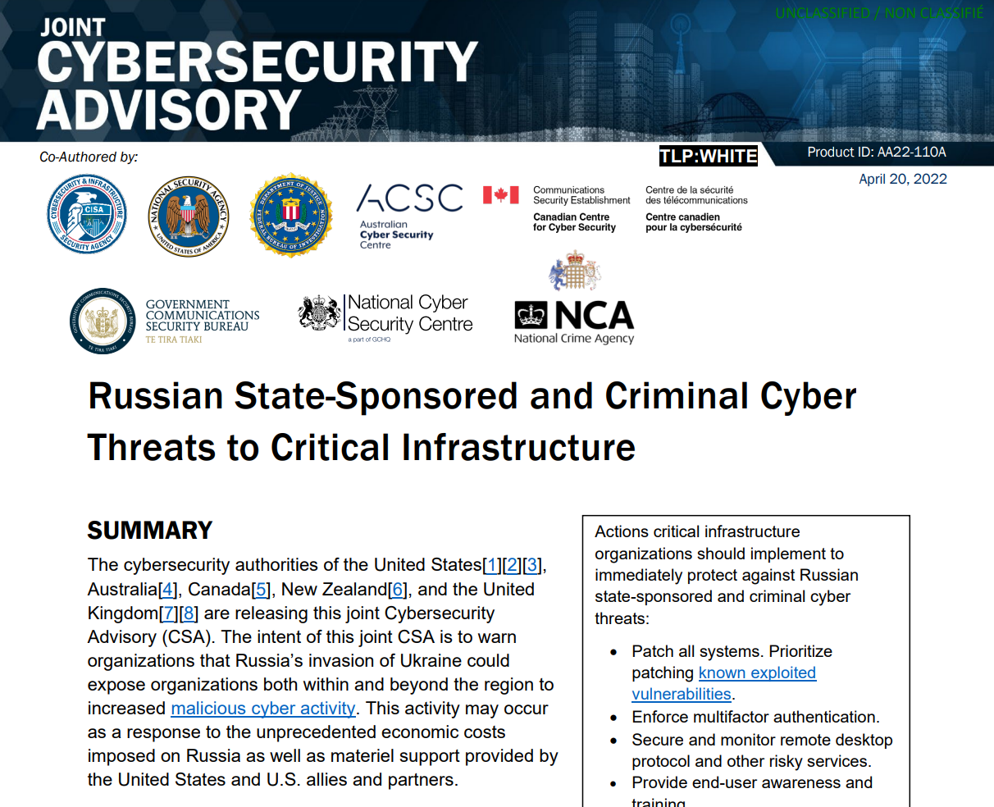
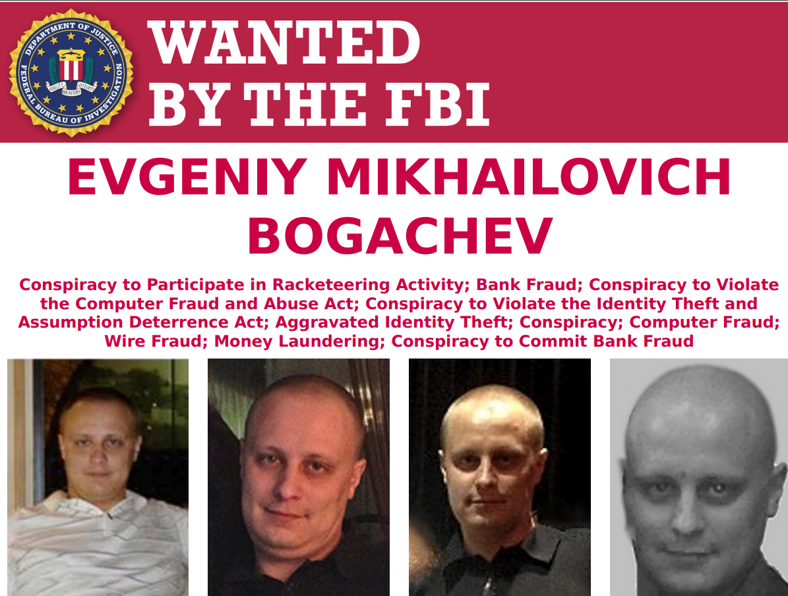

Slide 11
The business of cybercrime

Slide 12
Financially Motivated Cybercrime: Examples
Crime | Amount
Bangladesh Bank heist (2015) | US$80 million (attempted US$1 billion)
Bitfinex hack (2016) | BTC 119,754 (US$72 million at the time; US$4.8 billion now)
Coincheck hack (2018) | NEM 523 million (US$500 million)
Carbanak/Cobalt intrusions (2013-2018) | Up to $2 million per bank, total losses estimated at €1 billion by Europol
Ragnar Locker’s ransomware payment (2020) | US$4.5 million from CWT in a single payment

Slide 13
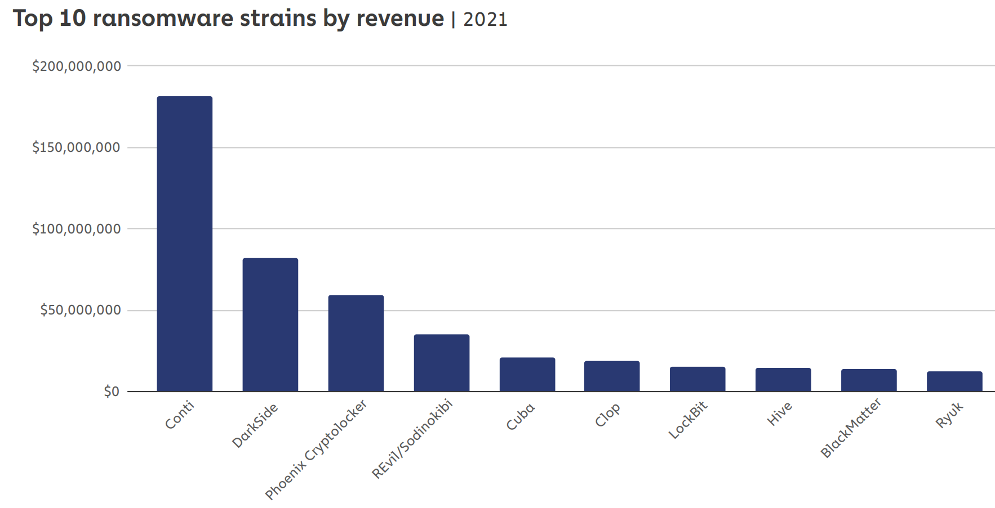
Ransomware
Source: Chainalysis, The 2022 Crypto Crime Report, February 2022, p. 39

Slide 14

Cyber- and organised crime

Slide 15
Links with (Offline) Organised Crime
Provision of money mule networks
Rutger Leukfeldt, Anita Lavorgna and Edward R Kleemans, ‘Organised Cybercrime or Cybercrime that is Organised? An Assessment of the Conceptualisation of Financial Cybercrime as Organised Crime’, European Journal on Criminal Policy and Research (Vol. 23, No. 287, 2017), p. 291
Involvement in drug trafficking and human trafficking
Rutger Leukfeldt and Jurjen Jansen, ‘Cyber-Criminal Networks and Money Mules: An Analysis of Low-Tech and High-Tech Fraud Attacks in the Netherlands’, International Journal of Cyber Criminology (Vol. 9, No. 2, 2015), pp. 17, 175
Investment in cybercrime by organised crime groups
Jonathan Lusthaus, ‘Is the Mafia Taking Over Cybercrime?’, Black Hat USA 2018 Conference

Slide 16

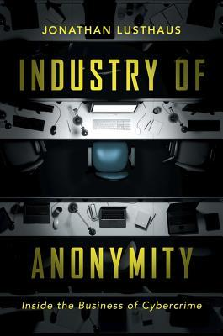
Assets such as property: 30%
Reinvested in criminal activity: 20%
Disorganised or hedonistic spending: 20%
Immediate needs, e.g. bills and food): 15%
Status items: 15%
Michael McGuire, Into the Web of Profit: An In-Depth Study of Cybercrime, Criminals and Money, Bromium, April 2018, p. 100
Jonathan Lusthaus, The Industry of Anonymity (OUP 2018)

Slide 17
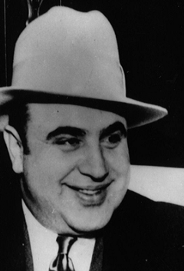
What is the connection with money laundering?

Slide 18
Proceeds in fiat currency:
Bank account takeovers
Fraud, e.g. BEC
SWIFT intrusions
ATM hacks
Money laundering:
Money mules
Shell companies
Money remitters
Cash couriers
Use
Proceeds in digital currency:
Cryptocurrency theft
Crypto-jacking
Cybercrime-as-a-service
Money laundering:
Peel chains
Mixers
Chain-hopping
Use

Slide 19
Traditional financial sector

Slide 20
Victim
Unwitting facilitator

Slide 21
Money Mule Accounts
An account controlled by someone working for a cybercriminal:
Employment scams
Romance scams
A hacked account;
A purchased account;
An account opened with a fake ID.

Slide 22
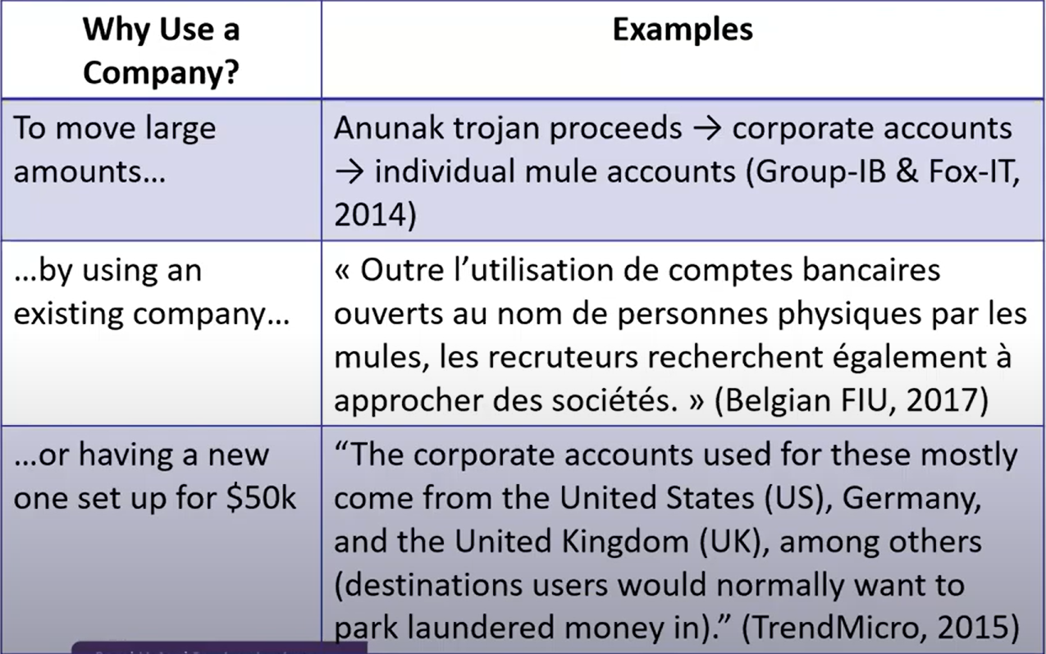
Corporate Accounts

Slide 23
Regulatory Requirements
Risk assessment
Customer due diligence
Filing suspicious matter reports (SMRs), threshold transaction reports (TTRs) and international funds transfer instruction (IFTI) reports
Reports received and analysed by the Australian Transaction Reports and Analysis Centre (AUSTRAC)

Slide 24
Example of a Success Story
Tomáš Jiříkovský, the administrator of the Dark Web market Sheep Marketplace, was sentenced to nine years in prison in the Czech Republic after he stole the equivalent of $731,600 in bitcoin from the market’s users. He invested $345,000 derived from the sale of bitcoins into purchasing a house, which was subsequently seized by law enforcement. The investigation was triggered by a suspicious transaction report from the bank where his partner had her account in relation to the transfer of $35,000 from a bitcoin exchange to her.
Sources: BayPay Forum, ‘Czech Police Seize $345,000 Property Linked to Bitcoin Hack’, 1 April 2015; Deep Dot Web, ‘Sheep Marketplace Owner Indicted and Faces Years in Prison’, 21 April 2017.

Slide 25
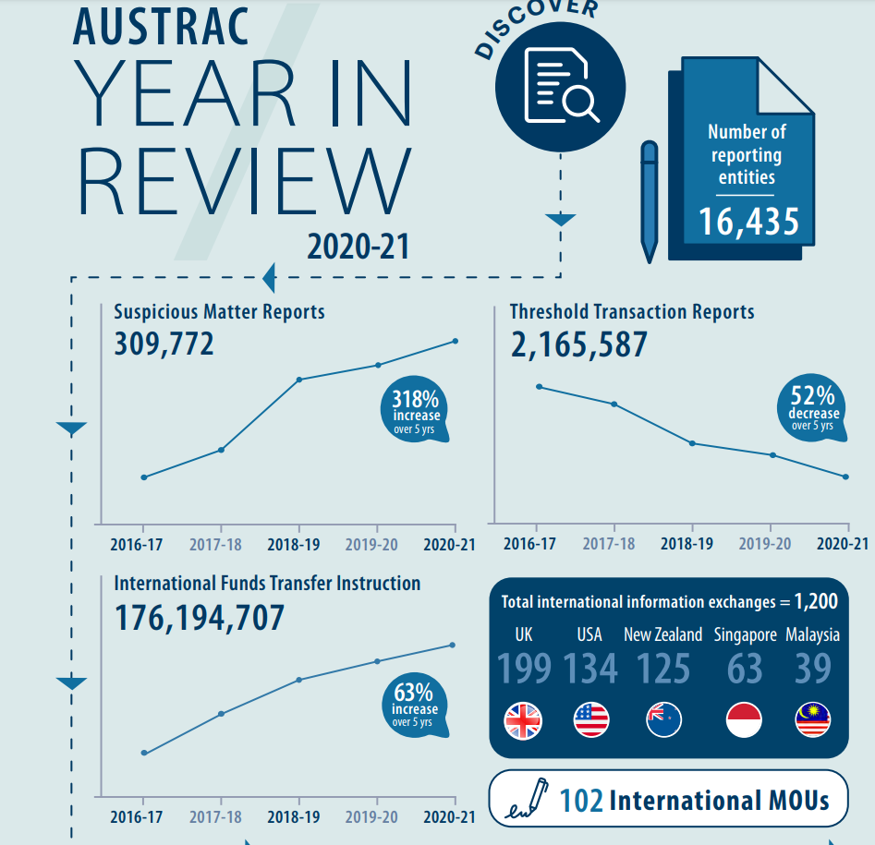
Challenges
Over-reporting (false positives)
Under-reporting (false negatives)
Lack of the right information in reports

Slide 26
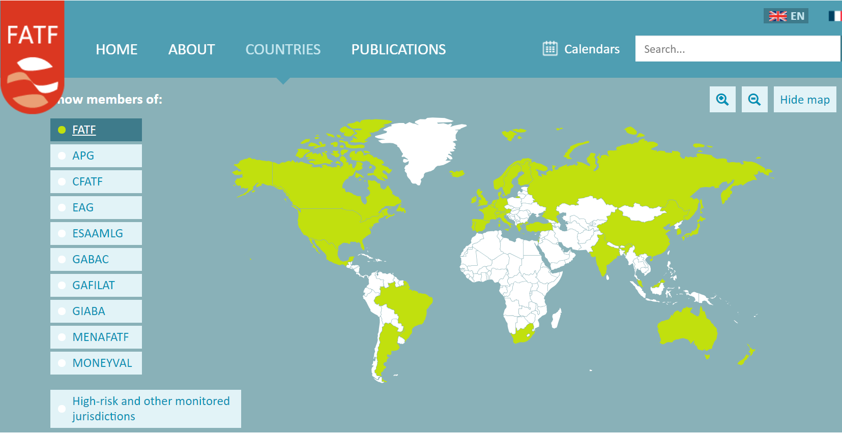

Slide 27

FATF – Origins
Amongst the original group of twelve participant countries everyone threw their hobby horse into the discussion: the United States suggested cash controls, the UK notification of suspicious transactions, and the Swiss wanted their newly invented concept of identification of customers to be internationalized. Overall, the elements were stitched together in the so-called “40 Recommendations” and frankly – at the time (in 1989) – no one believed they would survive the next three months.
Mark Pieth

Slide 28
Search for Solutions
Analysis of customers’ digital footprint within banks
Public-private partnerships (Fintel Alliance)
Privacy-enhancing technologies
How can the right incentives be created?

Slide 29
cryptocurrency

Slide 30
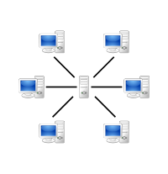
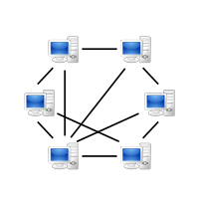
Types of Virtual Assets
Centralised virtual assets:
WebMoney
Liberty Reserve (now defunct)
Decentralised virtual assets (cryptocurrency):
Bitcoin
Altcoins (Ether, Ripple etc)

Slide 31

Liberty Reserve
A Costa Rica-based provider of centralised virtual assets
Processed transactions worth over US$8 billion
Arthur Budovsky, the scheme’s mastermind, sentenced to 20 years’ prison term in the US

Slide 32
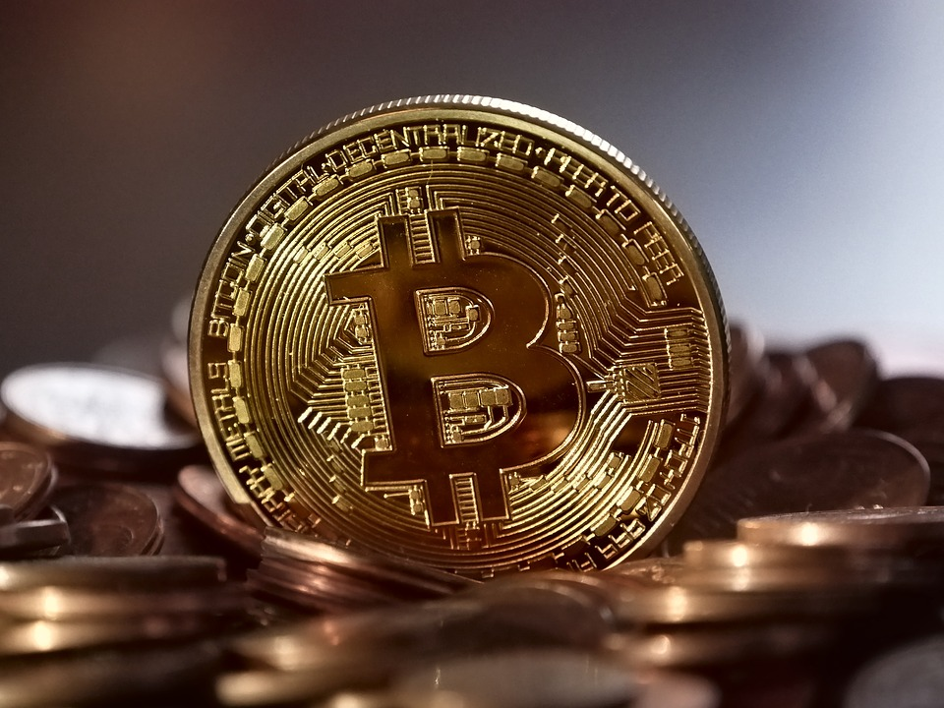
Why Would a Criminal Like Cryptocurrency?
Decentralisation
Pseudonymity/anonymity
New types of (cyber)crime:
Payments for cybercriminal services
Ransomware/DDOS extortion
Theft of virtual assets
Cryptojacking

Slide 33
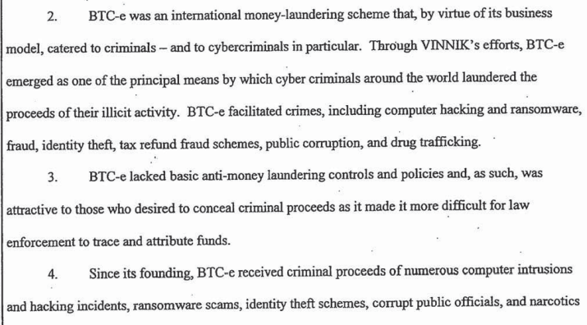

Slide 34
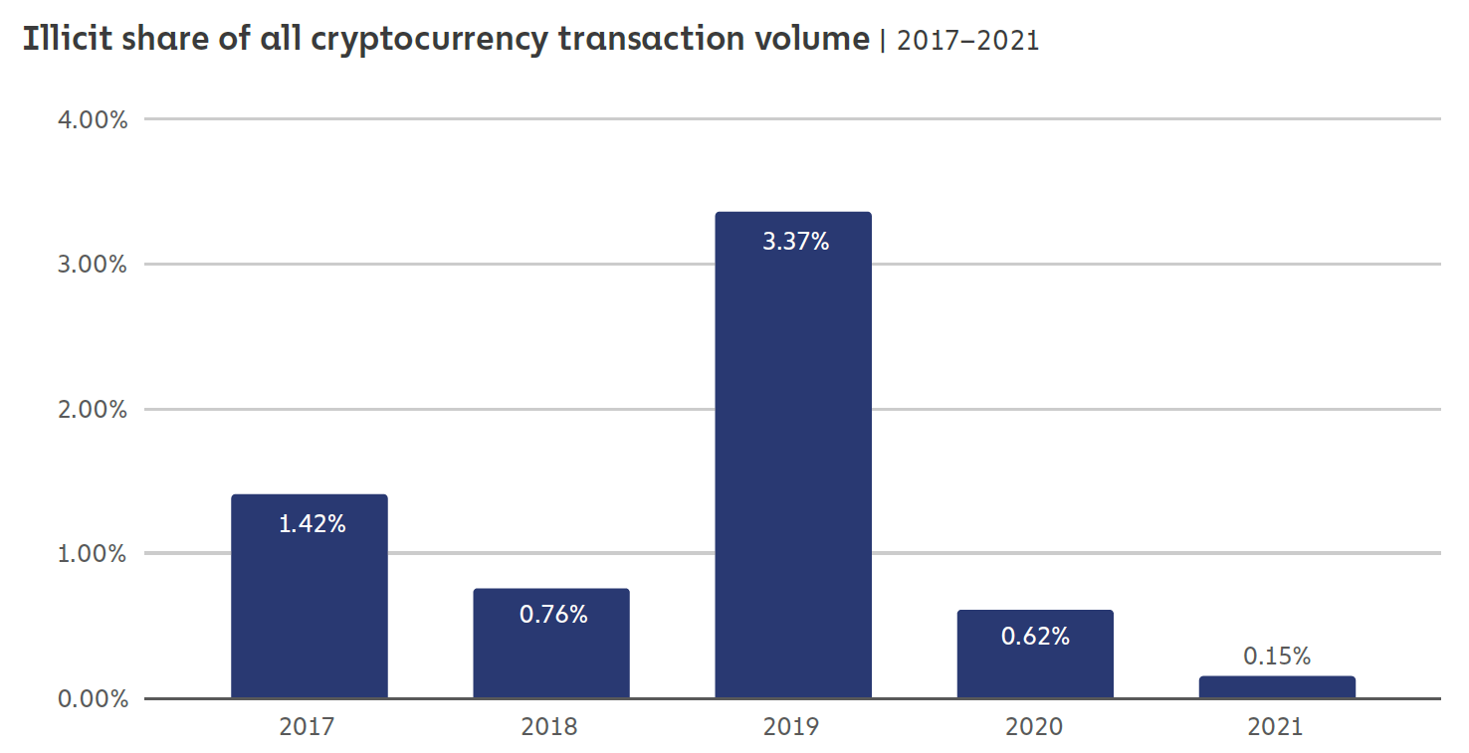
Criminal Use of Cryptocurrency
Source: Chainalysis, The 2022 Crypto Crime Report, February 2022, p. 4

Slide 35
Factors Affecting Criminal Use
De facto centralisation
Blockchain analytics
Volatility
Technical sophistication…?

Slide 36
Typical Money Laundering Techniques
In conducting these transactions, and as described further below, LICHTENSTEIN and MORGAN employed numerous money laundering techniques, including: (1) using accounts set up with fictitious identities; (2) moving the stolen funds in a series of small amounts, totaling thousands of transactions, as opposed to moving the funds all at once or in larger chunks; (3) utilizing computer programs to automate transactions, a laundering technique that allows for many transactions to take place in a short period of time; (4) layering the stolen funds by depositing them into accounts at a variety of VCEs and darknet markets and then withdrawing the funds, which obfuscates the trail of the transaction history by breaking up the fund flow; (5) converting the BTC to other forms of virtual currency, including anonymity-enhanced virtual currency, in a practice known as “chain hopping”; and (6) using U.S.-based business accounts to legitimize activity.
Liechtenstein and Morgan Criminal Complaint, February 2022

Slide 37
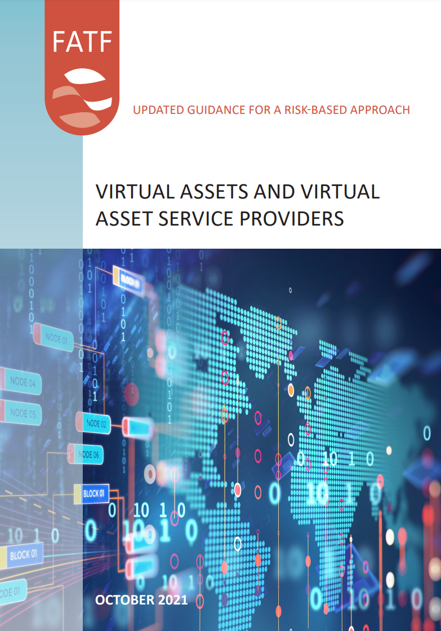
FATF’s Regulation
Recommendation 15:
To manage and mitigate the risks emerging from virtual assets, countries should ensure that virtual asset service providers are regulated for AML/CFT purposes, and licensed or registered and subject to effective systems for monitoring and ensuring compliance with the relevant measures called for in the FATF Recommendations.

Slide 38
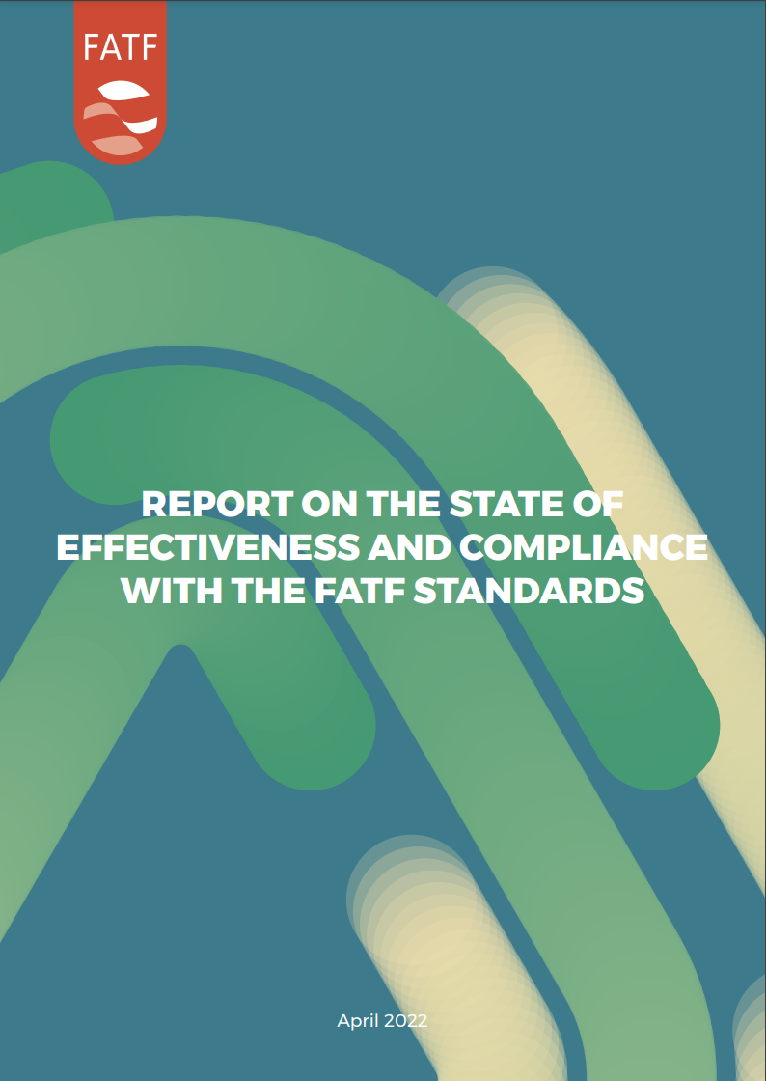
Challenges
Over-reporting (false positives)
Under-reporting (false negatives)
Lack of the right information in reports
+ lack of regulatory infrastructure
+ suspicious activity looks different than in the traditional financial sector
+ cross-border business!

Slide 39
Geographical Reach
Section 6(6) of the Anti-Money Laundering and Counter-Terrorism Financing Act 2006 (Cth):
[Australia’s AML/CTF regulation] does not apply to the provision by a person of a service to a customer unless:
(a) the service is provided at or through a permanent establishment of the person in Australia; or
(b) both of the following subparagraphs apply:
(i) the person is a resident of Australia;
(ii) the service is provided at or through a permanent establishment of the person in a foreign country; or
(c) both of the following subparagraphs apply:
(i) the person is a subsidiary of a company that is a resident of Australia;
(ii) the service is provided at or through a permanent establishment of the person in a foreign country.

Slide 40
Addressing the risk
Ensuring enforcement

Slide 41
Sanctions
Today’s actions include the Department of the Treasury’s Office of Foreign Assets Control’s (OFAC) designation of SUEX OTC, S.R.O. (SUEX), a virtual currency exchange, for its part in facilitating financial transactions for ransomware actors. SUEX has facilitated transactions involving illicit proceeds from at least eight ransomware variants. Analysis of known SUEX transactions shows that over 40% of SUEX’s known transaction history is associated with illicit actors. (September 2021)
Garantex is a virtual currency exchange founded in late 2019 and originally registered in Estonia. Garantex allows customers to buy and sell virtual currencies using fiat currencies. The majority of Garantex’s operations are carried out in Moscow, including at Federation Tower, and St. Petersburg, Russia, where other sanctioned virtual currency exchanges have also operated. Analysis of known Garantex transactions shows that over $100 million in transactions are associated with illicit actors and darknet markets, including nearly $6 million from Russian RaaS gang Conti and also including approximately $2.6 million from Hydra. (April 2022)

Slide 42
Thank you
Get in touch at:
anton.moiseienko@anu.edu.au

